Slide 1


Decarbonization Target and Pathway Recommendation
[Company logo]

Slide 2
Agenda
1.
2.
3.
Executive summary and agenda
Business benefits of setting a decarbonization target
Target-setting roadmap
4.
5.
6.
[Company]’s decarbonization pathway
Recommendation and next steps
Appendix

Slide 3
Executive Summary
Section 01

Slide 4
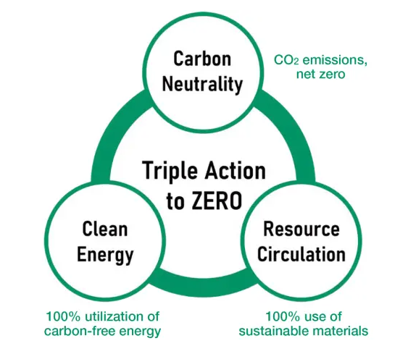

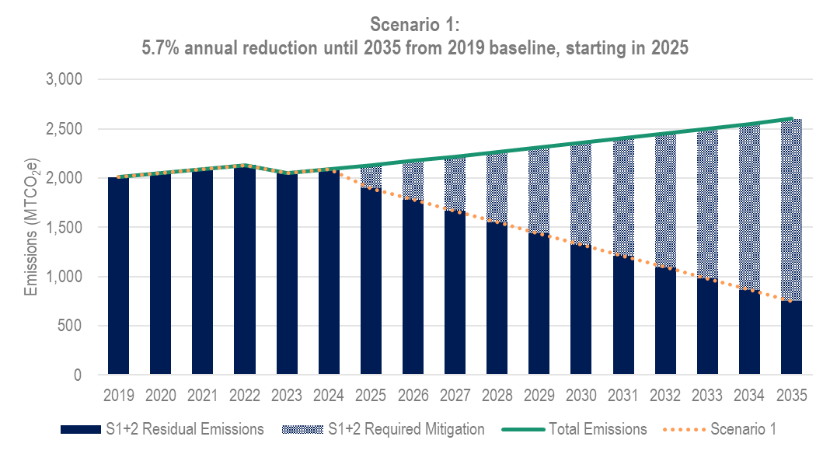

Executive summary
Honda set carbon neutrality goal with Triple Zero 2050 Vision
Honda requires suppliers to set internal carbon neutrality goals
Suppliers must set targets and develop decarbonization pathway
Notes:
Honda has set a carbon neutrality goal that includes reducing the suppliers’ own greenhouse gas emissions
Honda has therefore set requirements for Direct Tier 1 and Raw Materials suppliers to reduce their carbon emissions
Honda suppliers must therefore set carbon reduction targets in line with Honda’s requirements in order for Honda to meet their own decarbonization goals
Honda considers suppliers who achieve these requirements to be more competitive as future partners compared with those who don’t

Slide 5

Objectives
Today’s primary goal is to seek leadership approval for decarbonization targets for operations that support Honda business lines
Confirm business drivers and value of setting a decarbonization target in line with Honda
Ensure a common understanding of decarbonization target requirements
Evaluate financial and decarbonization KPIs for decarbonization target pathway(s)
Understand risks and opportunities to achieve the recommended target
Align on way forward for decarbonization target strategy, and external communications plan
Notes:
[]

Slide 6
Team
Name
Title
Function
Name
Title
Function
Name
Title
Function
Name
Title
Function
Name
Title
Function
Notes:
[A note to the presenter: The intent is to show the stakeholders who have engaged throughout the process. Highlight the role and support each of the included stakeholders has provided]

Slide 7
Business benefits of setting a decarbonization target
Section 03

Slide 8


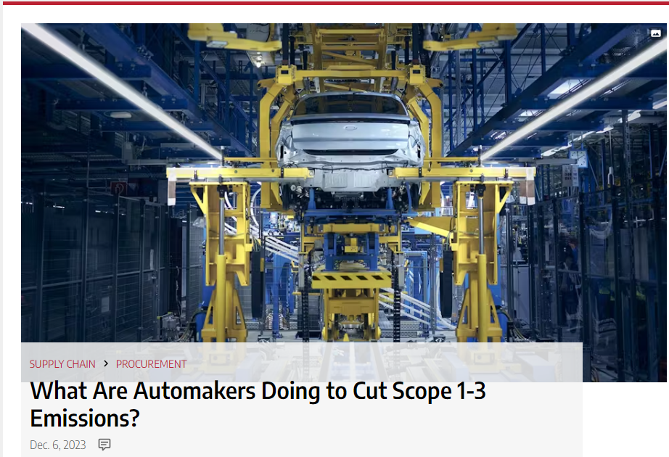
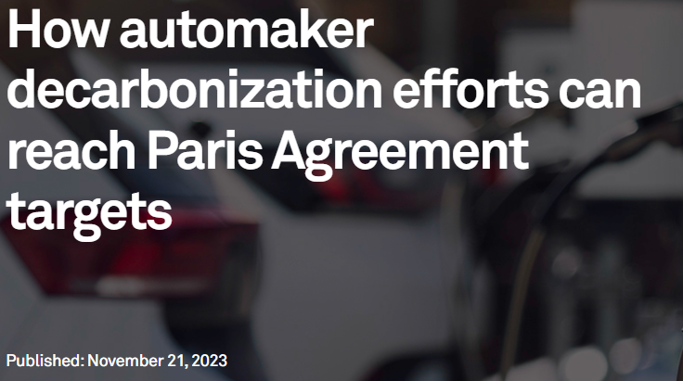
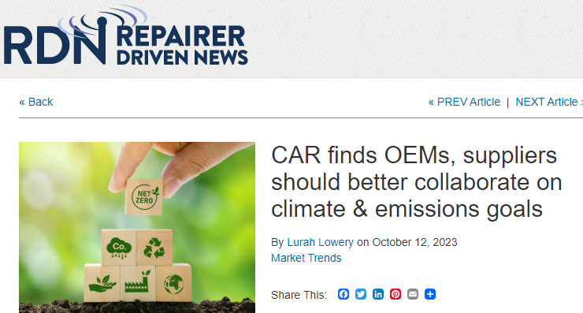

Automotive industry aligning on decarbonizing the supply chain
Automotive OEMs expect suppliers to decarbonize
The automotive industry is setting decarbonization targets across their supply chain, driven by:
  Investor requirements
  Climate-related disclosure frameworks
  Regulatory requirements
  Increased customer awareness of climate change impacts
(spglobal.com)
What Are Automakers Doing to Cut Scope 1-3 Emissions? | IndustryWeek
Growing Collaboration of Global Automakers and Suppliers Driving Carbon Reporting and Reduction through Supply Chain - Suppliers Partnership for the Environment
https://www.repairerdrivennews.com/2023/10/12/car-finds-oems-suppliers-should-better-collaborate-on-climate-emissions-goals/
Notes:
Automotive OEMs are facing increasing expectations from investors, regulators, and customers to reduce carbon emissions
These pressures include reducing carbon emissions in the automotive supply chain
Automotive OEMs are, therefore, increasingly expecting suppliers to set reduce carbon emissions
Automotive OEMs are also investing and collaborating to support suppliers in setting and achieving these carbon reduction targets

Slide 9
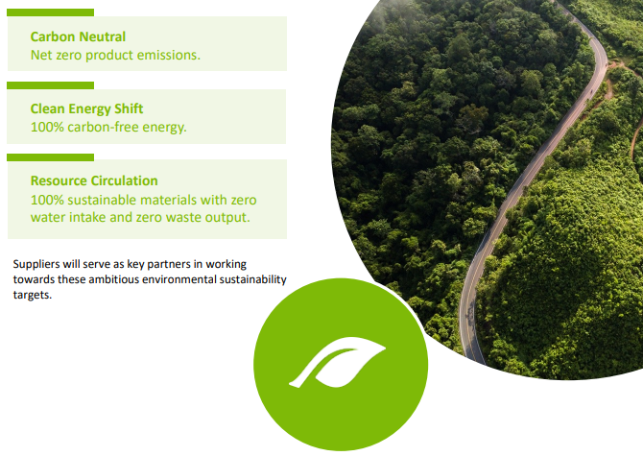
Honda’s Triple Zero 2050 Vision
Honda expects suppliers to align with its own carbon neutral goal for all operations that support Honda’s business lines.
Suppliers are required to:
  Set internal targets that meet or exceed Honda’s annual 5.7% (+) absolute CO₂e reduction target from 2025 reporting year through 2035 (from a 2019 baseline)
  Set internal targets aligned with achieving carbon neutrality by 2050
  Report emissions annually to M2030
  Identify decarbonization and renewable energy opportunities
  Create and execute a roadmap to achieve emissions reduction targets
Notes:
Honda expects suppliers to be carbon neutral by 2050, and ALSO expect suppliers to continuously reduce emissions between now and then
Specifically, this means reducing emissions 5.7% per year starting in 2025 through 2035 compared to a 2019 baseline. Ultimately, this means that suppliers must reduce their emissions by 63% compared to 2019 by the end of 2035.
At this time, this 63% reduction requirement applies to their suppliers’ Scope 1 (direct greenhouse gas emissions [such as due to fuel combustion]) and Scope 2 (emissions due to electricity related use)
Additionally, suppliers must set targets to achieve Scope 1 and Scope 2 carbon neutrality by 2050
To track progress to meeting these requirements, Honda requires suppliers to report their annual Scope 1 and Scope 2 emissions to a software called M2030
And to track whether suppliers are positioned to meet these reduction targets and requirements, Honda expects suppliers to develop a carbon reduction plan and roadmap – also communicated through M2030

Slide 10
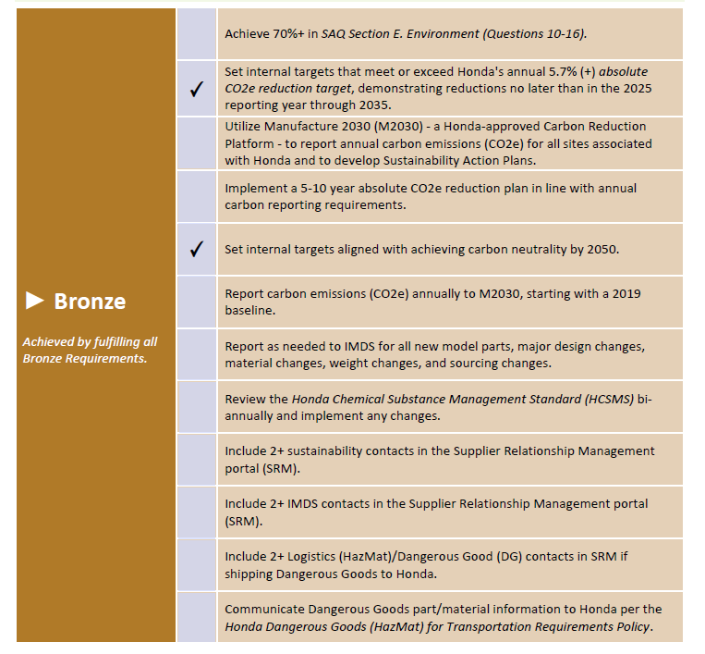
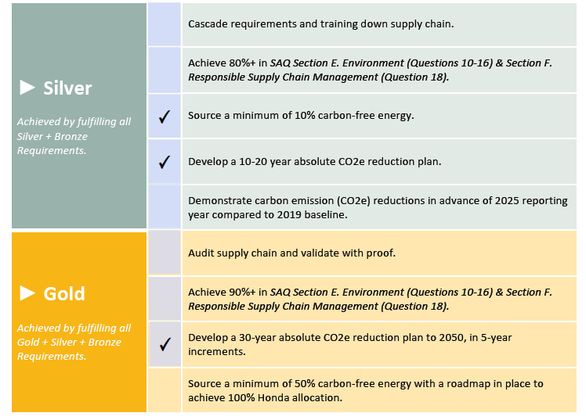


Driving a sustainable future with Honda
Successfully setting a decarbonization target in line with Honda’s goals will support 5 of the sustainability scorecard items
Notes:
Honda has created a Sustainability Scorecard to track suppliers’ progress toward achieving their requirements
Honda looks more favorably on suppliers who fulfill the actions in this scorecard
Setting a carbon reduction target and creating a decarbonization strategy checks 5 important boxes in the Honda Sustainability Scorecard.
Completing the Actions in this scorecard

Slide 11



How setting a decarbonization target strengthens [business]
Strengthen customer relationships
Collaborate across the value chain
Future-proof business
Automotive sector is driving toward carbon neutrality and OEMs are requiring suppliers to decarbonize. Investors and regulations are raising the bar for all companies
Aligning with key customer requirements signals commitment to business relationships
Honda’s Green Excellence program requires suppliers to drive emissions reductions through the value chain
Notes:
Setting and meeting carbon reduction targets has notable business benefits
As discussed, setting and meeting these targets strengthens relationships with customers (Honda included)
Achieving these targets will require collaboration across the supply chain. This presents a significant business opportunity to collaborate on products and processes to increase revenue and reduce cost.
Investors and regulations will increasingly demand progress on carbon reduction. Focusing attention to this now will ensure your business is ready for compliance

Slide 12
Target-setting roadmap
Section 02

Slide 13






Our roadmap to recommending [Company]’s decarbonization target
01. Create your internal Project Team
Dedicate a Project Lead and create a Project Team consisting of the stakeholders needed to review and approve a target
03. Create your decarbonization strategy
Model your carbon emissions and calculate the impact that certain initiatives can have on your carbon emissions
05. Report your target
Update M2030 with your target commitment and earn progress on your Honda Supplier Sustainability Scorecard
02. Understand key priorities for leadership
Review the “why” with your company’s leaders and learn what information they need to feel comfortable approving a carbon reduction target
04. Gain leadership approval for your strategy
Present your decarbonization strategy to leadership to win approval to set a carbon reduction target
Notes:
[A note to the presenter: this roadmap is intended to show leadership the process of developing the decarbonization pathway presented in the next few slides]

Slide 14
Decarbonization pathway
Section 04

Slide 15
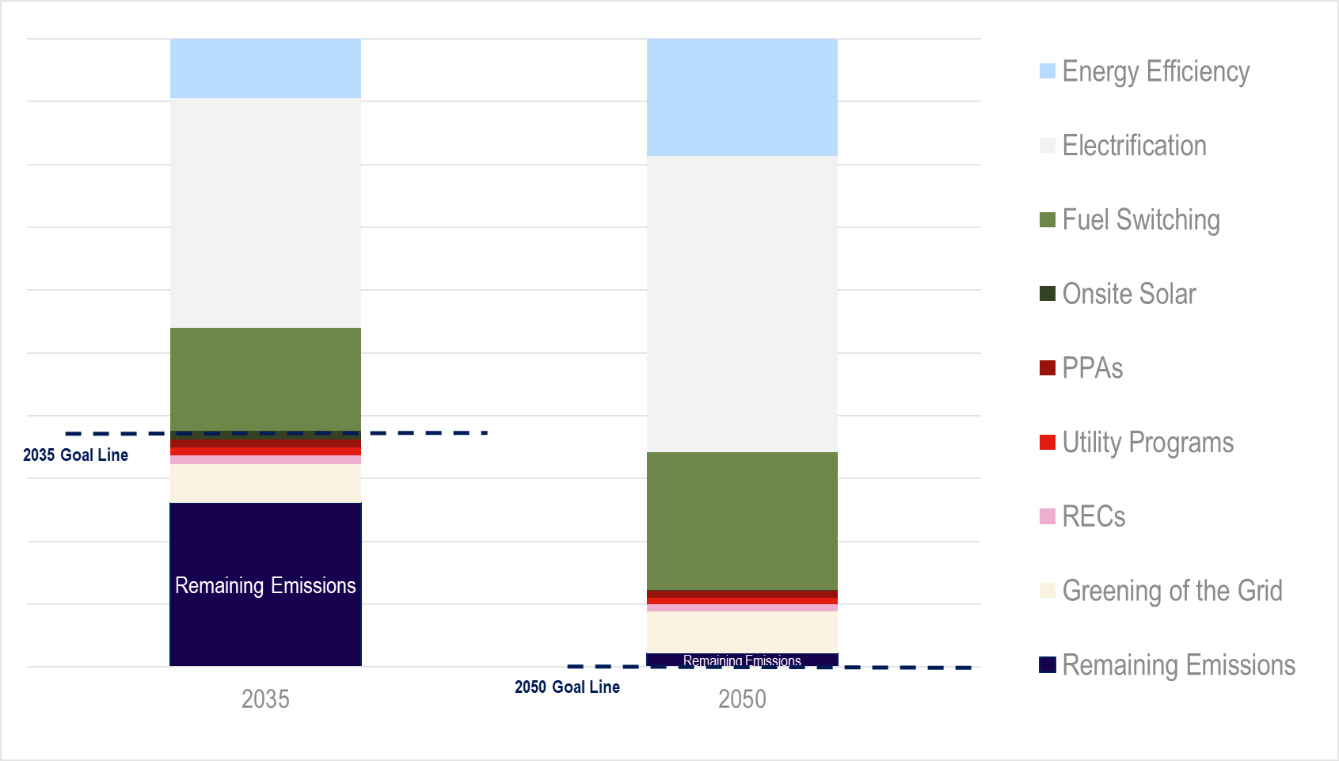
Decarbonization Pathway
Key Takeaways:
[Company] can implement a portfolio approach to reduce carbon emissions below Honda’s goal requirements
The selected strategy (meets/does not meet) Honda’s decarbonization requirements
The strategy was selected to (minimize capital/maximize savings/optimize ROI/insert other stated priorities from leadership)
Paste the Decarbonization Strategy table here
Notes:
[A note to the presenter: This is the slide where you show the pathway aligns with leadership priorities, which should be determined early on in this process of determining a decarbonization pathway and setting a target]

Slide 16
2035 Near-term Decarbonization Financial Implications
Paste the 2035 Strategy Financial Implications table here
Key Takeaways:
Capital expense on the order of ____ to _____ would be required to meet Honda’s targets by 2035
The overall annual expense impact would be ____ to ____ of dollars in (cost/savings)
Some projects are likely to have a good ROI including ______
Key:
$ - Cost Savings
$ - Cost Additive
✓ - Highly likely ROI
o – Uncertain ROI
x – No ROI
Disclaimer: The information provided is intended to give guidance on the resources required for initiative implementation. These costs are directional and can vary based on specific market conditions and requirements
Notes:
The Key Takeaways here show us the sort of investment that would be required to meet Honda’s carbon reduction targets.
We are NOT seeking approval for the investments modeled here, rather we are looking for feedback as to whether this sort of investment is possible for the company between now and 2035.

Slide 17
2050 Long-term Decarbonization Financial Implications
Paste the 2050 Strategy Financial Implications table here
Key Takeaways:
Capital expense on the order of ____ to _____ would be required to meet Honda’s targets by 2050
The overall annual expense will be ____ to ____ (cost/savings)
Some projects are likely to have a good ROI including ______
Key:
$ - Cost Savings
$ - Cost Additive
✓ - Highly likely ROI
o – Uncertain ROI
x – No ROI
Disclaimer: The information provided is intended to give guidance on the resources required for initiative implementation. These costs are directional and can vary based on specific market conditions and requirements
Notes:
The Key Takeaways here show us the sort of investment that would be required to meet Honda’s carbon reduction targets.
We are NOT seeking approval for the investments modeled here, rather we are looking for feedback as to whether this sort of investment is possible for the company between now and 2050.

Slide 18
Recommendation and next steps
Section 05

Slide 19



Recommendation and next steps
Commit to near-term absolute CO₂e reduction target in line with Honda
    Base year: 2019
    Target year: 2035
    Target: Annual 5.7% reduction starting in 2025
Commit to carbon neutrality by 2050
Communicate commitments to Honda - meet Bronze requirements on Supplier Sustainability Scorecard by selecting “Yes” in the Targets and Management portion of the Manufacture2030 questionnaire
Notes:
[A note to the presenter: This is intended as a call to action. Please adjust accordingly for your organization’s preferred approach.]
In light of the range of investment we’ve seen in the previous section, can we commit to the carbon reduction targets Honda is asking of us?

Slide 20


Looking ahead
Setting a decarbonization target is a critical step toward:
Ensuring an aligned and sustainable business relationship with Honda
Operationalizing efficiencies and enabling long-term resource planning
Incorporating sustainability metrics into capital planning and budgeting processes
Selecting decarbonization projects for evaluation and execution
Notes:
[A note to the presenter: Include next steps from stakeholder and leadership engagement]

Slide 21
Questions?

Slide 22
Thank you
[Company logo]
Name goes here
Job title goes here
emailaddress@trioadvisory.com
00 00000 000000

Slide 23
Appendix
Section 06

Slide 24
Decarbonization pathway percentages
Paste the Decarbonization Strategy table here
Paste the Decarbonization Pathway Percentage table here
Notes:
This comparison shows the relative contribution of each lever toward the carbon reduction that is modeled
This is for informational purposes only and should provide context as to which levers may be most worth focusing on near-term

